Slide 1

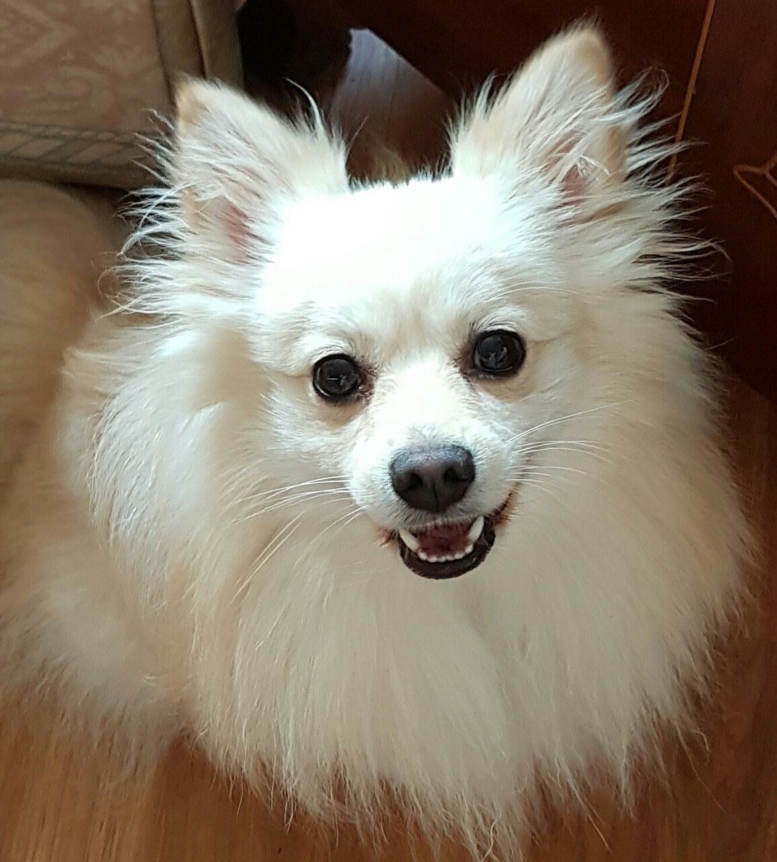

Safest Solution Group
WE MEET ALL OF YOUR NEEDS

Slide 2
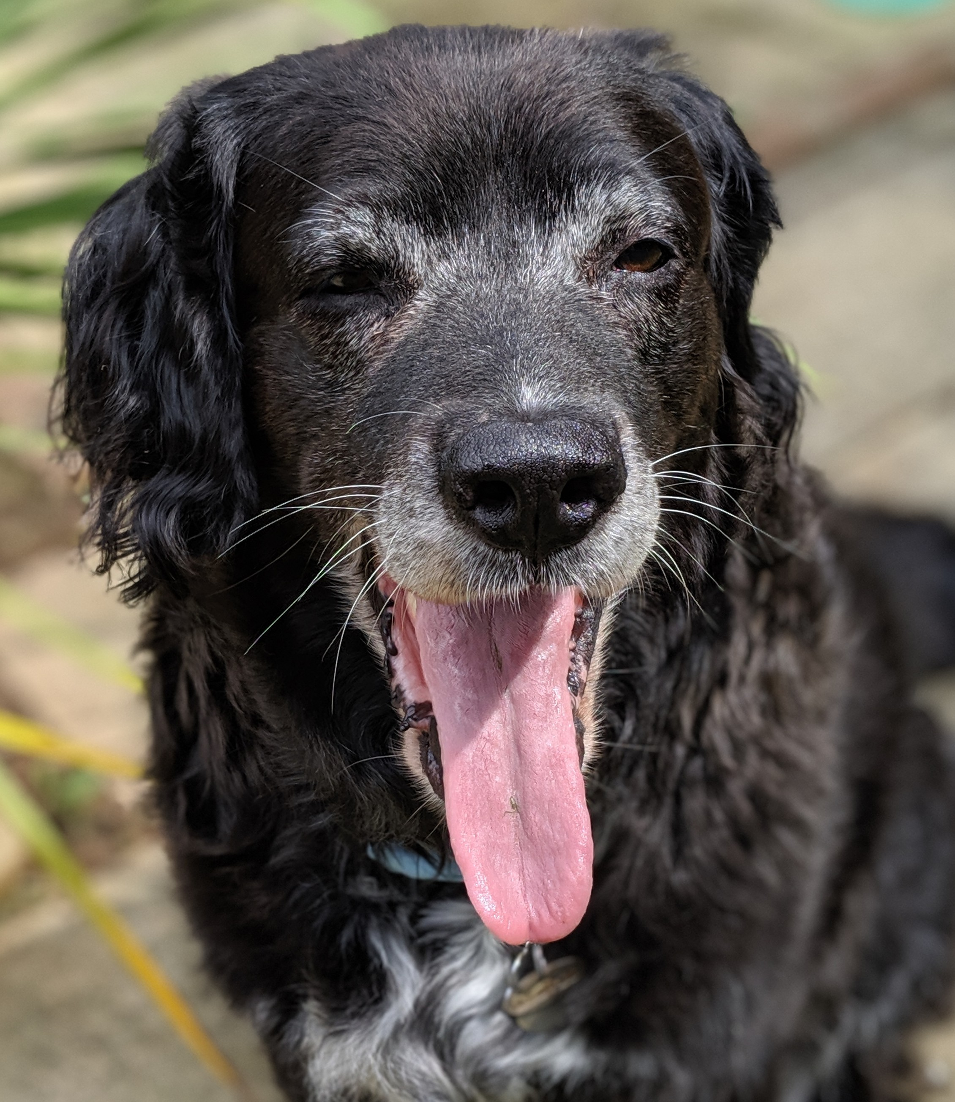
Furkiddz Benefits
Free month of cover
Kennel boarding whilst on holiday
Access to Cut your Nails scheme
One free workshop
Cover at any stage of your furkiddz life
Teeth clean once every 3 months
One bag of treats – first vet appointment
Ear check

Slide 3
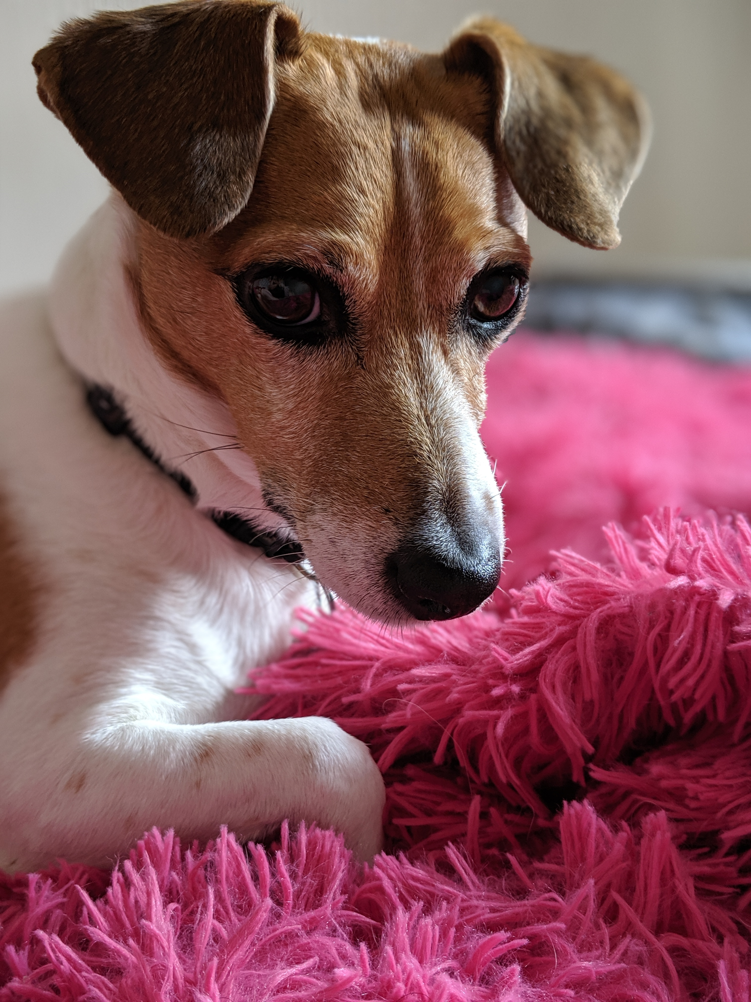
Workshops for You
Every 2nd Friday afternoon
Booking : furkiddz@safestsol.co.ni
Nail Workshop
Managing the Winter Walks
Time to De-worm
Conditions and Coping
Best Eating Program

